Slide 1

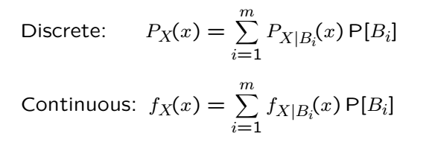



Total Probability Theorem for RVs
Let be a partition of the sample space
Then we have:
Intuition: To “draw” from the distribution we first randomly
chose with probability and then draw from

Slide 2
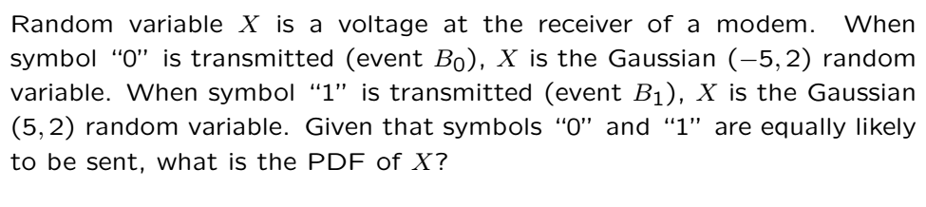
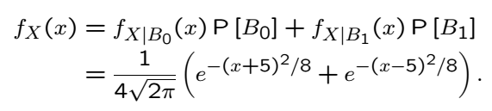
Example
Sum of two bell curves with different means
This is known as a “mixed Gaussian distribution”

Slide 3
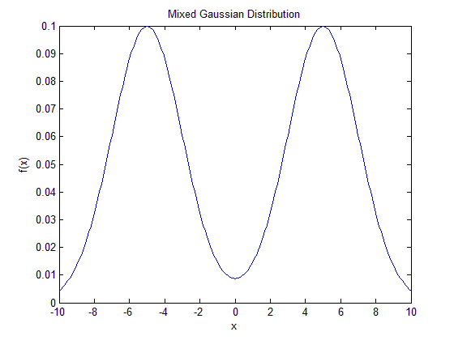
Example Cont’

Slide 4
Acknowledgements and Citations
Parts of these slides are adapted from the following resources:
Power Point Lecture Slides for the Textbook http://bcs.wiley.com/hebcs/Books?action=index&bcsId=8676&itemId=1118324560
John Tsitsiklis. 6.041 Probabilistic Systems Analysis and Applied Probability, Fall 2010. (Massachusetts Institute of Technology: MIT OpenCourseWare),http://ocw.mit.edu (Accessed 13 Apr, 2015). License: Creative Commons BY-NC-SA

